Slide 1
Полиња воJava
Предавач: д-р Цвета Мартиновска
Фонд на часови: 2+2+2

Slide 2
class Pole
{
public static void main(String[] args)
{
int j;
long kluc;
long[] arr = {77,99,44,55,22,88,11,00,66,33};
int brElem = 10;
for(j=0; j<brElem; j++)
System.out.print(arr[j] + " ");
System.out.println("");
kluc = 66;
for(j=0; j<brElem; j++)
if(arr[j] == kluc)
break; // elementot e najden
if(j == brElem) // ne e najden
System.out.println("Ne e pronajden " + kluc);
else
System.out.println("Pronajden " + kluc);
kluc = 55; // izbrisi 55
for(j=0; j<brElem; j++)
if(arr[j] == kluc)
break;
for(int k=j; k<brElem-1; k++)
arr[k] = arr[k+1];
brElem--;
for(j=0; j<brElem; j++)
System.out.print( arr[j] + " ");
System.out.println("");
}//end main
} // end class

Slide 3
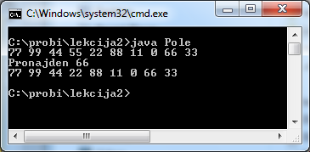

Slide 4
class EdPole {
private long[] a;
public EdPole(int size) { a = new long[size]; }
public void setElem(int index, long value)
{ a[index] = value; }
public long getElem(int index)
{ return a[index]; }
}
class EdPoleApp {
public static void main(String[] args)
{
EdPole arr;
arr = new EdPole(100);
int nElems = 0;
int j;
arr.setElem(0, 77);
arr.setElem(1, 99);
arr.setElem(2, 44);
arr.setElem(3, 55);
arr.setElem(4, 22);
nElems = 5;
for(j=0; j<nElems; j++)
System.out.print(arr.getElem(j) + " ");
System.out.println("");
int kluc = 26;
for(j=0; j<nElems; j++)
if(arr.getElem(j) == kluc)
break;
if(j == nElems)
System.out.println("Ne e najden " + kluc);
else
System.out.println("Najden " + kluc);
for(j=0; j<nElems; j++)
if(arr.getElem(j) == 55)
break;
for(int k=j; k<nElems; k++)
arr.setElem(k, arr.getElem(k+1) );
nElems--;
for(j=0; j<nElems; j++)
System.out.print( arr.getElem(j) + " ");
System.out.println("");
}
}

Slide 5
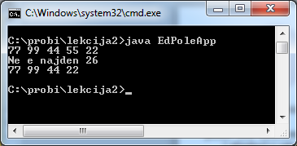

Slide 6
public boolean delete(long value)
{
int j;
for(j=0; j<brElem; j++)
if( value == a[j] )
break;
if(j==brElem)
return false;
else
{
for(int k=j; k<brElem; k++)
a[k] = a[k+1];
brElem--;
return true;
}
} // end delete()
public void display()
{
for(int j=0; j<brElem; j++)
System.out.print(a[j] + " ");
System.out.println("");
}
} // end class SlPole
class SlPole
{
private long[] a;
private int brElem;
public SlPole(int max)
{
a = new long[max];
brElem = 0;
}
public boolean find(long kluc)
{
int j;
for(j=0; j<brElem; j++)
if(a[j] == kluc)
break;
if(j == brElem)
return false;
else
return true;
} // end find()
public void insert(long value)
{
a[brElem] = value;
brElem++;
}

Slide 7
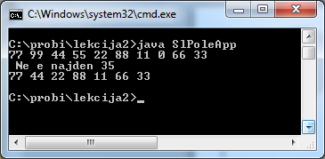
if( arr.find(kluc) )
System.out.println("Najden " + kluc);
else
System.out.println(" Ne e najden " + kluc);
arr.delete(00);
arr.delete(55);.delete(99);
arr.display();
} // end main()
} // end class SlPoleApp
class SlPoleApp
{
public static void main(String[] args)
{
int maxSize = 100;
SlPole arr;
arr = new SlPole(maxSize);
arr.insert(77);
arr.insert(99);
arr.insert(44);
arr.insert(55);
arr.insert(22);
arr.insert(88);
arr.insert(11);
arr.insert(00);
arr.insert(66);
arr.insert(33);
arr.display();
int kluc = 35;

Slide 8
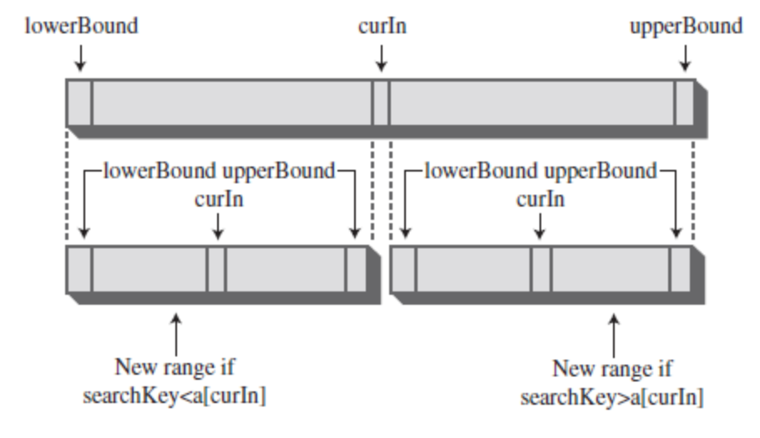
public int find(long kluc)
{
int lowerBound = 0;
int upperBound = brElem-1;
int curIn;
while(true)
{
curIn = (lowerBound + upperBound ) / 2;
if(a[curIn]==kluc)
return curIn; // elementot e najden
else if(lowerBound > upperBound)
return brElem; // elementot ne e najden
else
{
if(a[curIn] < kluc)
lowerBound = curIn + 1; // vo gorna polovina
else
upperBound = curIn - 1; // vo dolna polovina
} // end else divide range
} // end while
} // end find()

Slide 9
public void insert(long value) {
int j;
for(j=0; j<brElem; j++)
if(a[j] > value)
break;
for(int k=brElem; k>j; k--)
a[k] = a[k-1];
a[j] = value;
brElem++;
} // end insert()
public boolean delete(long value) {
int j = find(value);
if(j==brElem)
return false;
else // najden
{
for(int k=j; k<brElem; k++)
a[k] = a[k+1];
brElem--;
return true;
}
} // end delete()
public void display()
{
for(int j=0; j<brElem; j++)
System.out.print(a[j] + " ");
System.out.println("");
}
}
class PodredenoPole {
private long[] a;
private int brElem;
public PodredenoPole(int max) {
a = new long[max];
brElem = 0;
}
public int size() { return brElem; }
public int find(long kluc) {
int lowerBound = 0;
int upperBound = brElem-1;
int curIn;
while(true) {
curIn = (lowerBound + upperBound ) / 2;
if(a[curIn]==kluc)
return curIn; // najden
else if(lowerBound > upperBound)
return brElem; // ne e najden
else // podeli go opsegot
{
if(a[curIn] < kluc)
lowerBound = curIn + 1;
else
upperBound = curIn - 1;
} // end else
} // end while
} // end find()

Slide 10
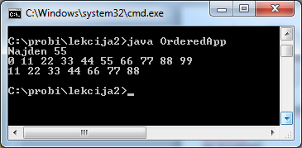
class OrderedApp
{
public static void main(String[] args)
{
int maxSize = 100;
PodredenoPole arr;
arr = new PodredenoPole(maxSize);
arr.insert(77);
arr.insert(99);
arr.insert(44);
arr.insert(55);
arr.insert(22);
arr.insert(88);
arr.insert(11);
arr.insert(00);
arr.insert(66);
arr.insert(33);
int kluc = 55;
if( arr.find(kluc) != arr.size() )
System.out.println("Najden " + kluc);
else
System.out.println(" Ne e najden " + kluc);
arr.display();
arr.delete(00);
arr.delete(55);
arr.delete(99);
arr.display();
} // end main()
} // end class OrderedApp

Slide 11
class Licnost
{
private String Prezime;
private String Ime;
private int Godini;
public Licnost(String last, String first, int a)
{ // constructor
Prezime = last;
Ime = first;
Godini = a;
}
public void displayLicnost()
{
System.out.print(“ Prezime: “ + Prezime);
System.out.print(“, Ime: “ + Ime);
System.out.println(“, Godini: “ + Godini);
}
public String getLast()
{ return Prezime; }
} // end class Licnost

Slide 12
class KlasaPole
{
private Licnost[] a;
private int brElem;
public KlasaPole(int max) {
a = new Licnost[max];
brElem = 0;
}
public Licnost find(String searchName)
{
int j;
for(j=0; j<brElem; j++)
if( a[j].getLast().equals(searchName) )
break;
if(j == brElem)
return null;
else
return a[j];
}
public void insert(String last, String first, int Godini)
{
a[brElem] = new Licnost(last, first, Godini);
brElem++;
}
public boolean delete(String searchName)
{
int j;
for(j=0; j<brElem; j++)
if( a[j].getLast().equals(searchName) )
break;
if(j==brElem) // ne e najden
return false;
else // najden
{
for(int k=j; k<brElem; k++)
a[k] = a[k+1];
brElem--;
return true;
}
} // end delete()
public void displayA()
{
for(int j=0; j<brElem; j++)
a[j].displayLicnost();
}
} // end class KlasaPole

Slide 13
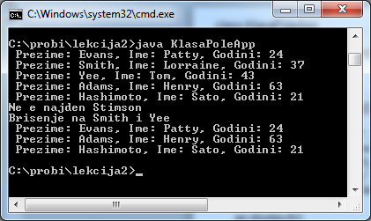
class KlasaPoleApp
{
public static void main(String[] args)
{
int maxSize = 100;
KlasaPole arr;
arr = new KlasaPole(maxSize);
arr.insert("Evans", "Patty", 24);
arr.insert("Smith", "Lorraine", 37);
arr.insert("Yee", "Tom", 43);
arr.insert("Adams", "Henry", 63);
arr.insert("Hashimoto", "Sato", 21);
arr.displayA();
String kluc = "Stimson";
Licnost found=arr.find(kluc);
if(found != null)
{
System.out.print("Najden ");
found.displayLicnost();
}
else
System.out.println("Ne e najden " + kluc);
System.out.println("Brisenje na Smith i Yee");
arr.delete("Smith");
arr.delete("Yee");
arr.displayA();
} // end main()
} // end class KlasaPoleApp

Slide 14
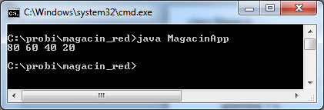
class Magacin
{
private int golemina;
private long[] pole;
private int top;
public Magacin(int s) {
golemina = s;
pole = new long[golemina];
top = -1;
}
public void push(long j) {
pole[++top] = j;
}
public long pop() {
return pole[top--];
}
public long peek() {
return pole[top];
}
public boolean isEmpty() {
return (top == -1);
}
public boolean isFull() {
return (top == golemina-1);
}
}
class MagacinApp
{
public static void main(String[] args)
{
Magacin mag = new Magacin(10);
mag.push(20);
mag.push(40);
mag.push(60);
mag.push(80);
while( !mag.isEmpty() )
{
long value = mag.pop();
System.out.print(value);
System.out.print(" ");
}
System.out.println("");
}
}

Slide 15
class Red{
private int golemina;
private long[] pole;
private int front;
private int rear;
private int brElem;
public Red(int s)
{
golemina = s;
pole = new long[golemina];
front = 0;
rear = -1;
brElem = 0;
}
public void vnesi(long j) {
if (rear == golemina-1)
rear = -1;
pole[++rear] = j;
brElem++;
}
public long izbrisi()
{
long temp = pole[front++];
if(front == golemina)
front = 0;
brElem--;
return temp;
}
public long peekFront()
{
return pole[front];
}
public boolean isEmpty()
{
return (brElem==0);
}
public boolean isFull()
{
return (brElem==golemina);
}
public int size()
{
return brElem;
}
}

Slide 16
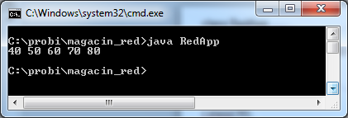
class RedApp
{
public static void main(String[] args)
{
Red r = new Red(5);
r.vnesi(10);
r.vnesi(20);
r.vnesi(30);
r.vnesi(40);
r.izbrisi();
r.izbrisi();
r.izbrisi();
r.vnesi(50);
r.vnesi(60);
r.vnesi(70);
r.vnesi(80);
while( !r.isEmpty() )
{
long n = r.izbrisi();
System.out.print(n);
System.out.print(" ");
}
System.out.println("");
}
}

